Slide 1
Wireframe of six twelve
This is what I have so far

Slide 2
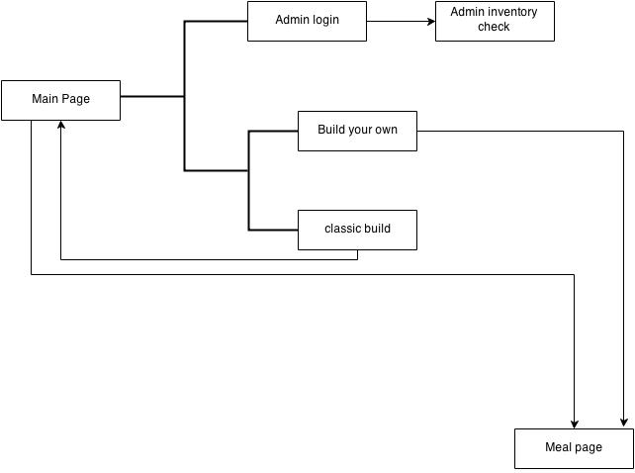
Wireframe diagram

Slide 3
Wireframe diagram
Main page: The main page of the website showing the 3 classic build sandwiches that allows customer to customize the ingredient of the 3 pre-built sandwiches. Have an add to meal button to guide the customers to meal page to better explore the nutrition fact of the food items they selected.
Admin login: This page contain a login panel that ask for admin to type in the correct login info to log in the system.
Admin inventory: This page can only be accessed after the admin log in the system and in this page the admin can remove the ingredient that the system no longer have or add/create new ingredient/food item(like a pre-built sandwich).
Meal: This page show the nutrition fact of the food items that the customers selected in main page or build your own page. The customer can delete the food item by uncheck the checkbox on the right.
Build your own: In this page, customers can build their own sandwich from scratch.

Slide 4
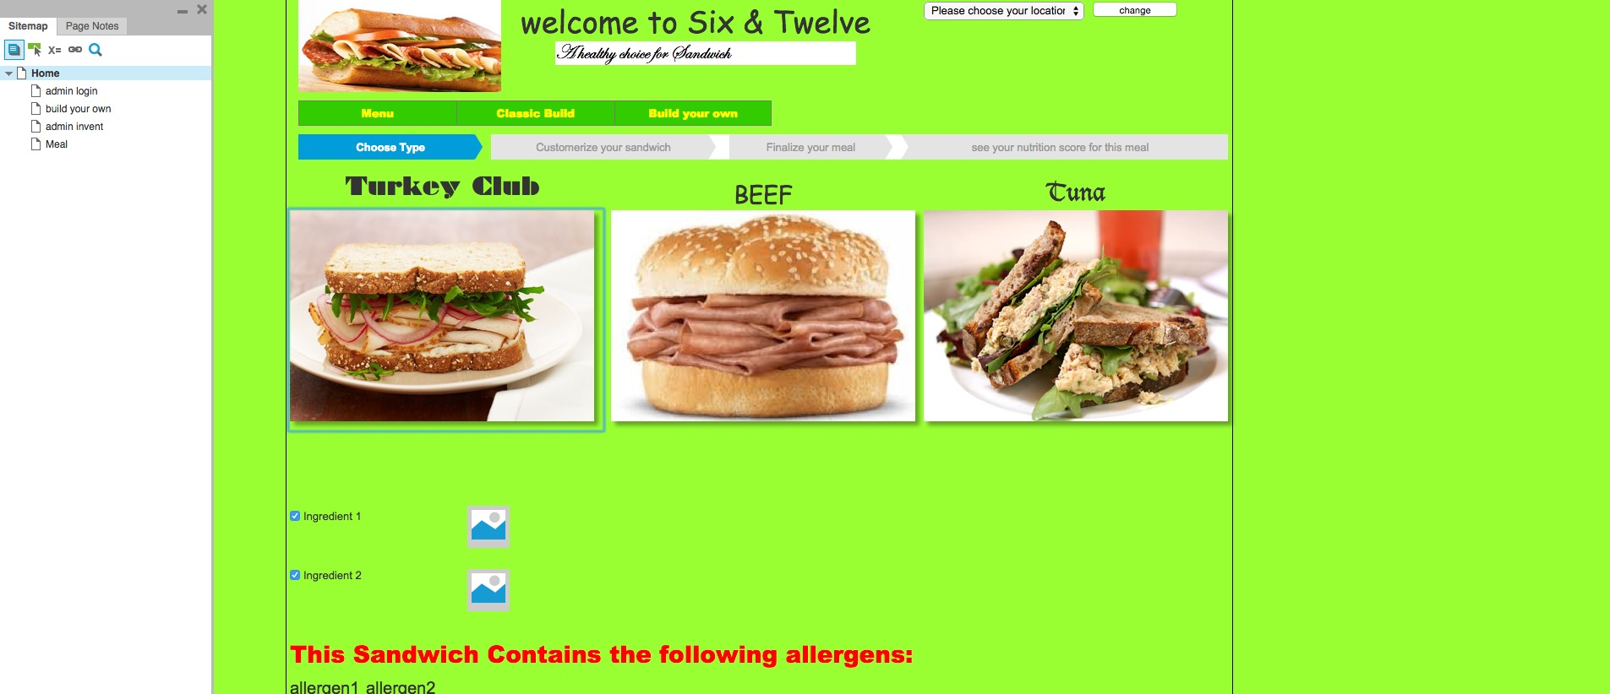
Main Page
The change location button and login button

Slide 5
Main Page
The 3 pre-built sandwiches can select the sandwich by a simply click

Slide 6
Main Page
Customer can uncheck the checkbox if they don’t want that ingredient.
The ingredient checkbox

Slide 7
Main Page
Allergens warning, that will change accordingly to the ingredients

Slide 8
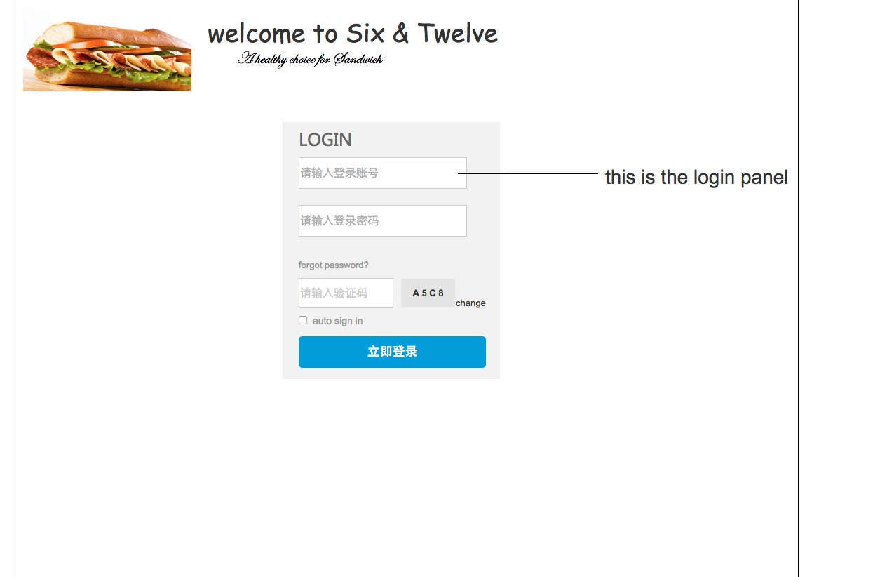
Admin login
username
password

Slide 9
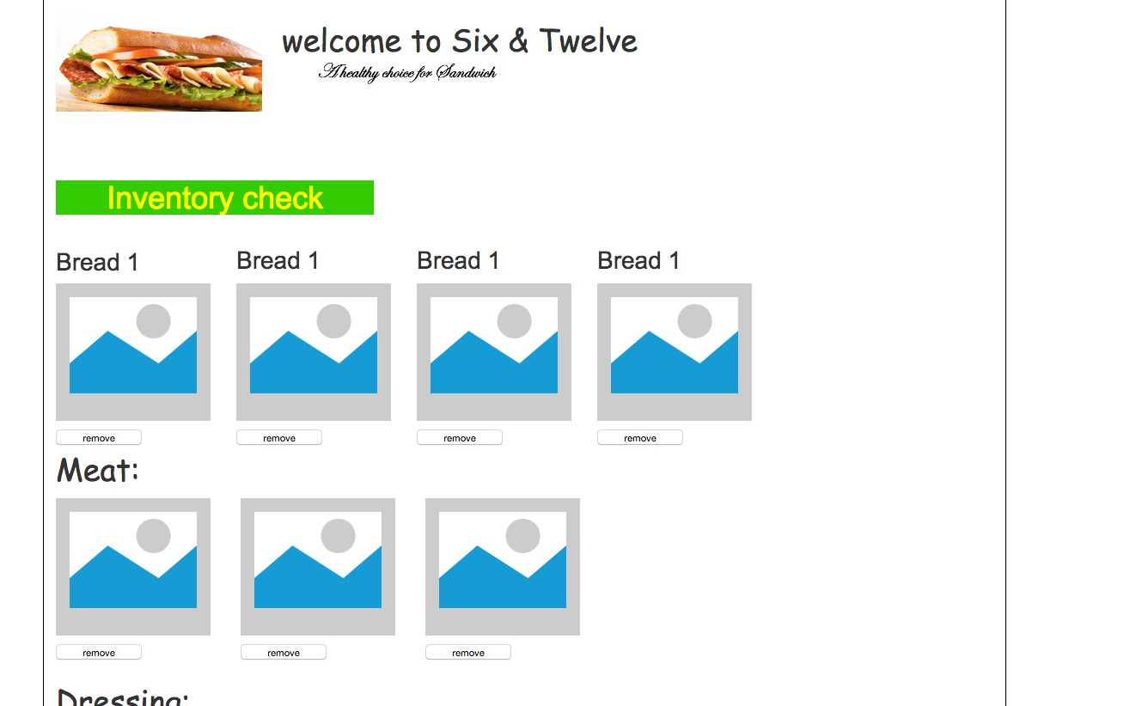
Admin inventory
Remove button allow you to remove the ingredient

Slide 10
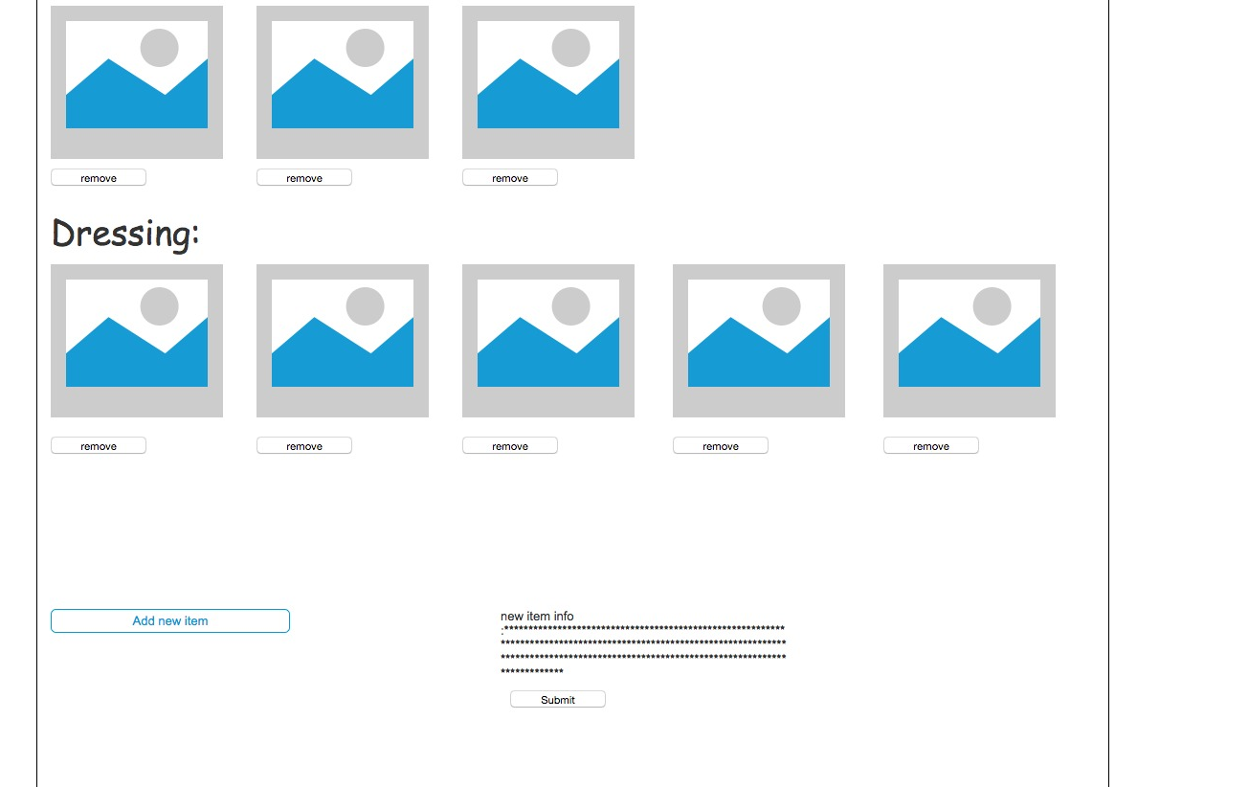
Admin inventory
You can edit the new item info here
Add new item button

Slide 11
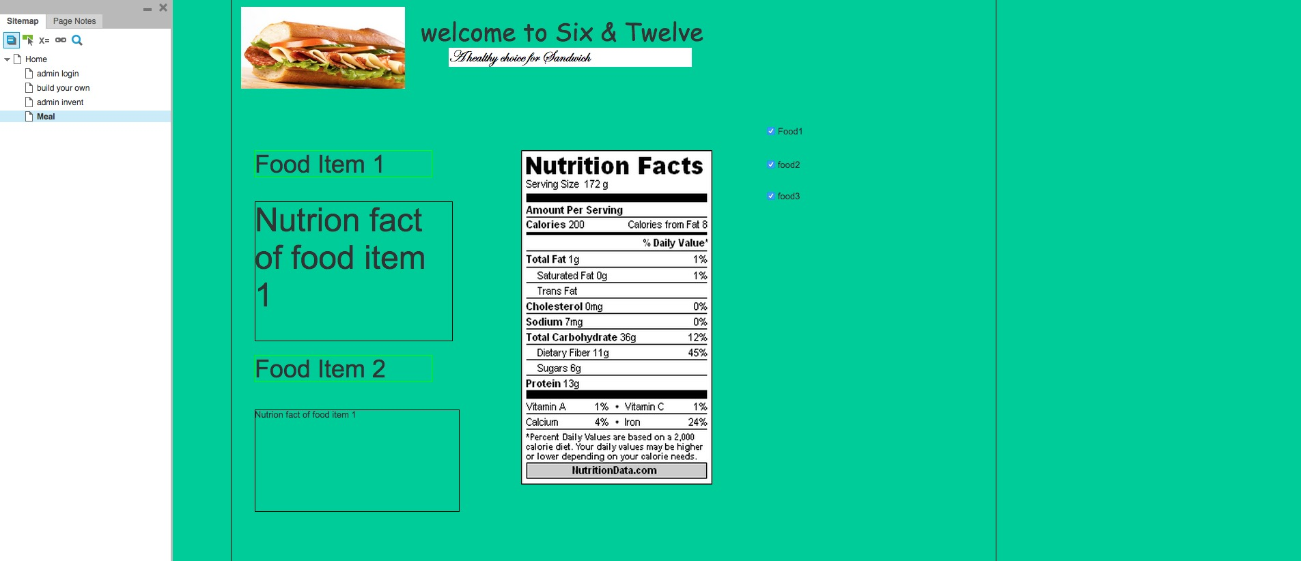
Meal page
Uncheck the checkbox to get rid of the unwanted the food item

Slide 12
Meal page
The nutrition fact label will change accordingly

Slide 13
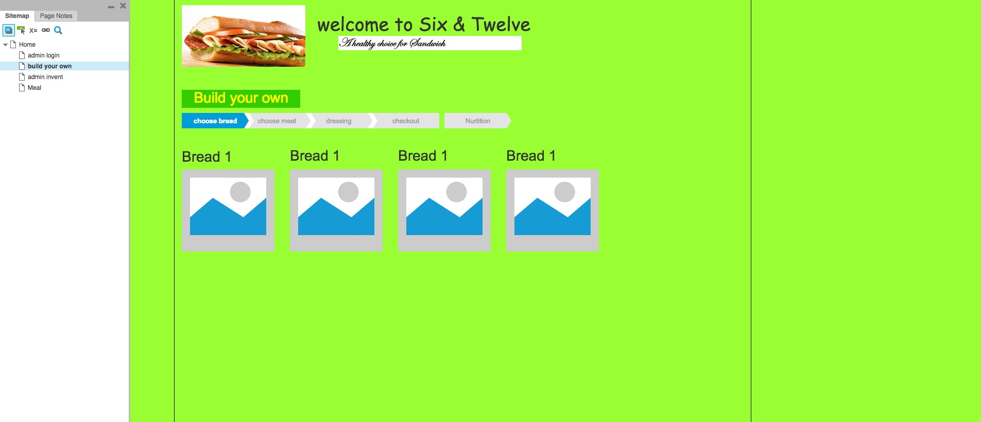
Build your page
Build your own sandwich step by step

Slide 14
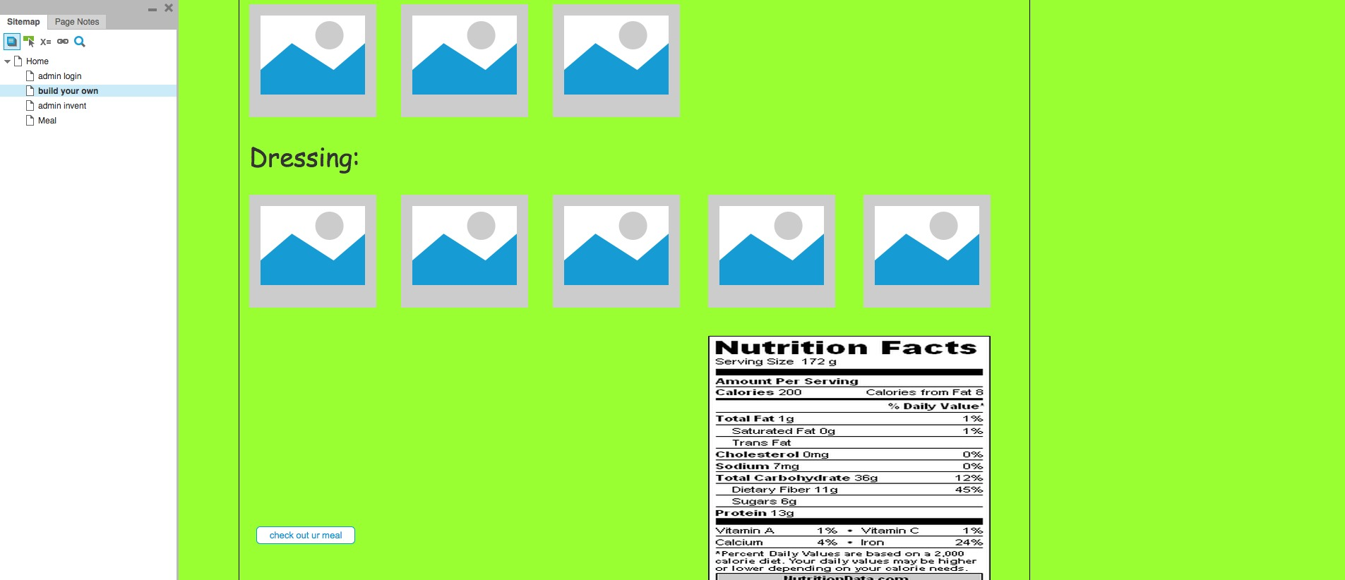
Build your own
After the customer build the sandwich they can check the nutrition fact by clicking on the button

Slide 15
Summary?

